Slide 1
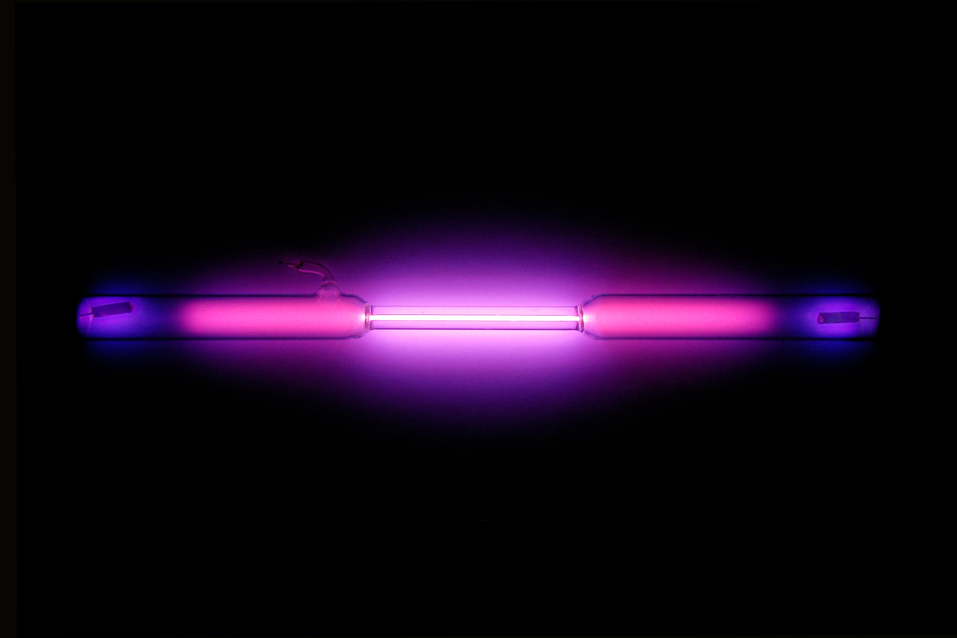
Phase Transitions of Argon
Argon Wikipedia

Slide 2
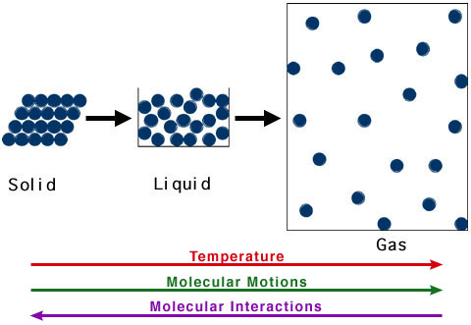
Core Concept
Simulate phase transition of substance
Observe changes in potential energy
Learn basics in Gromacs and molecule visualization (VMD, pymol)
R. Casiday and R. Frey, Washington University

Slide 3
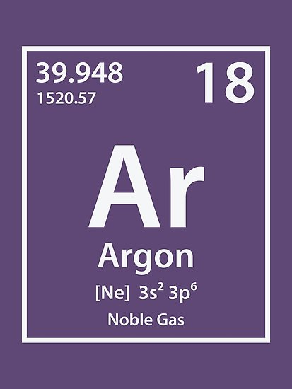
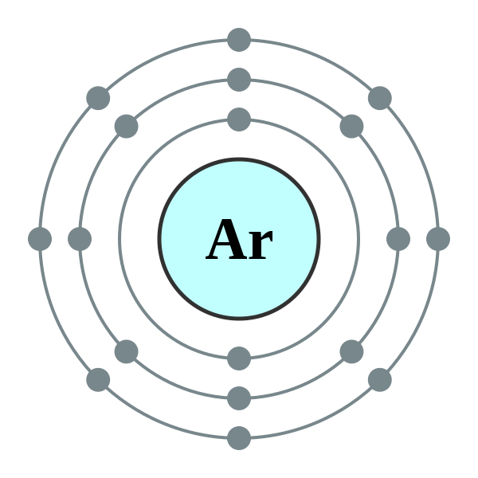
Argon
Noble gas → inert
Does not react
Monoatomic in all phases
Simple Force-Field
apolar
https://id.wikipedia.org/wiki/Berkas:Electron_shell_018_Argon_-_no_label.svg

Slide 4
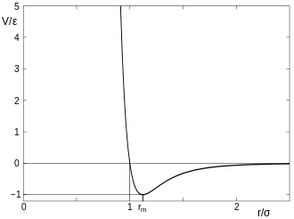
Strong repulsive
force
attraction
Force-Field
Pauli-Repulsion
Prevents overlapping
London-Dispersion
Induced dipol-dipol interaction
→ Lennard-Jones Potential
Lennard-Jones Potential (Quelle: wiki)

Slide 5
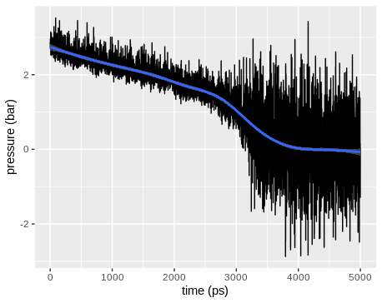
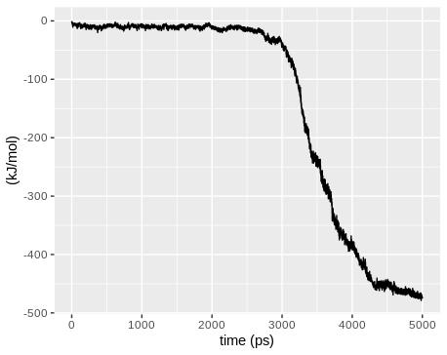
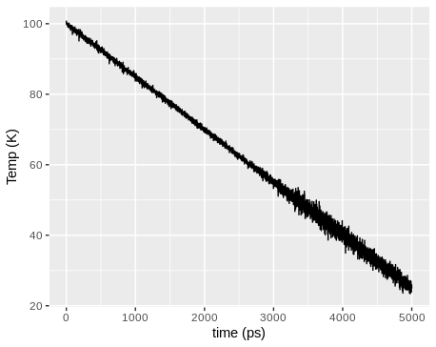
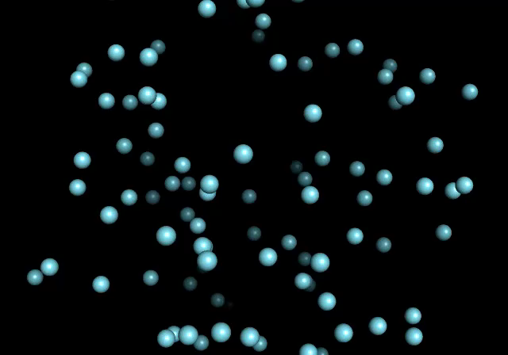
Cooling (gas → liquid)
Conditions:
controlled: atom count (fixed), volume (fixed) & tempreature (decreasing: 100 → 25°K)
Variable: pressure
Time: 5000 picoseconds

Slide 6
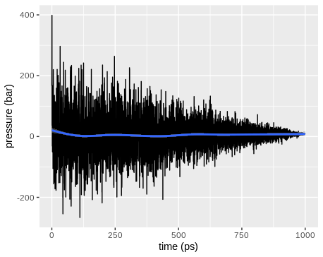
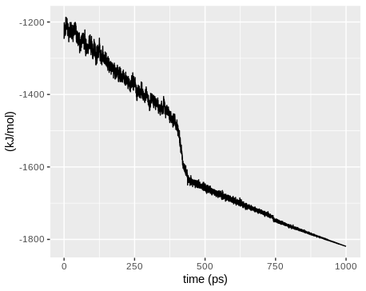
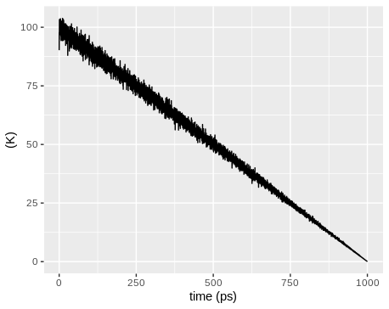
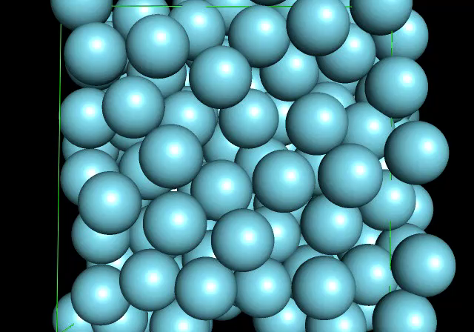
Cooling (fluid → solid)
Conditions:
controled: atom count (fixed), volume (fixed) & tempreature (decreasing: 100 → 0°K)
Variable: pressure
Time: 5000 picoseconds

Slide 7
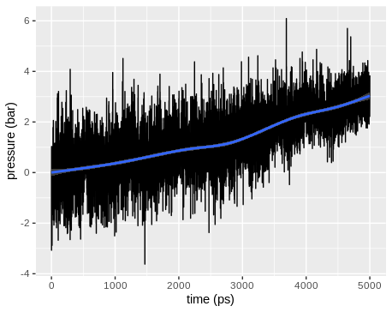
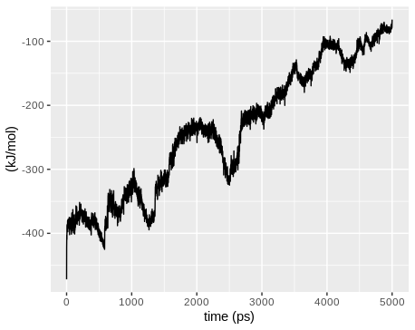
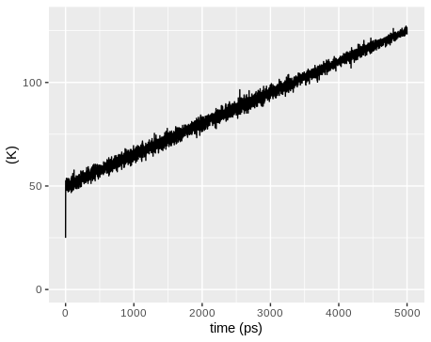
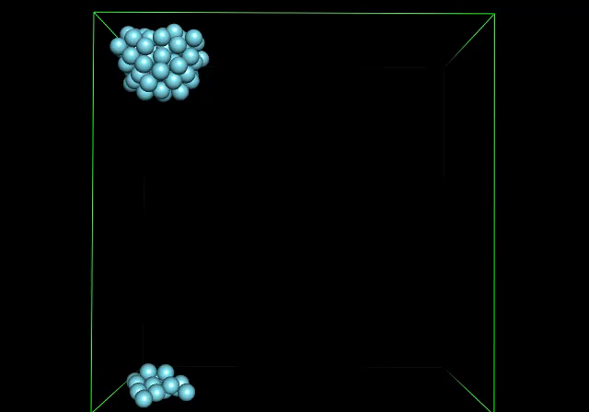
Heat up (fluid → gas)
Conditions:
controled: atom count (fixed), volume (fixed) & tempreature (increasing: 50 → 125°K)
Variable: pressure
Time: 5000 picoseconds

Slide 8
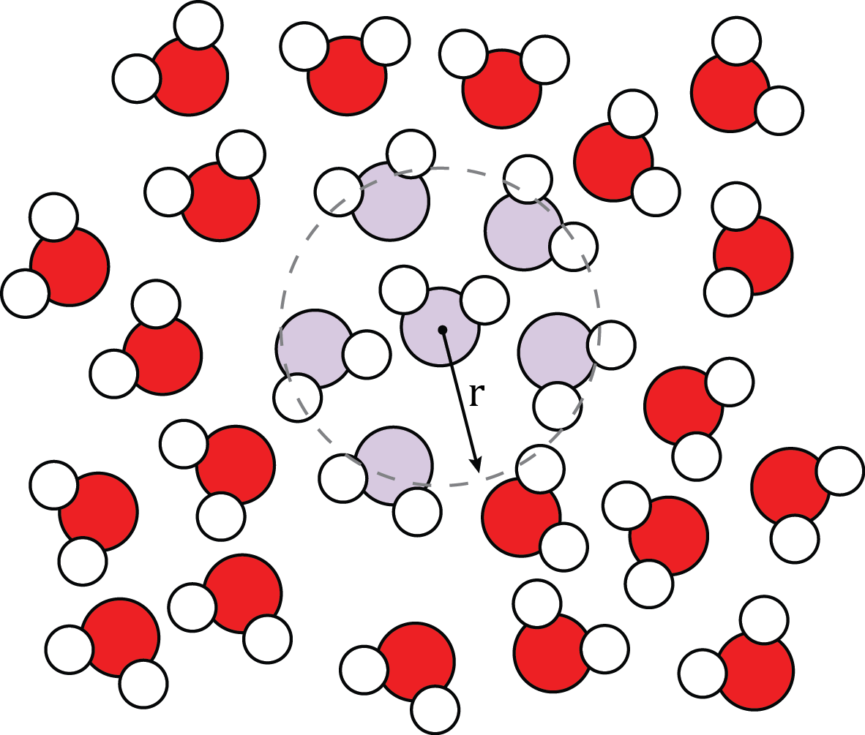
Radial Distribution Function
Defines probabilty to find other Atoms at distance r from a particle at the center
https://en.wikibooks.org/wiki/Molecular_Simulation/Radial_Distribution_Functions#/media/File:Molecular_Schematic_for_Interpreting_a_Radial_Distribution_Function.png

Slide 9
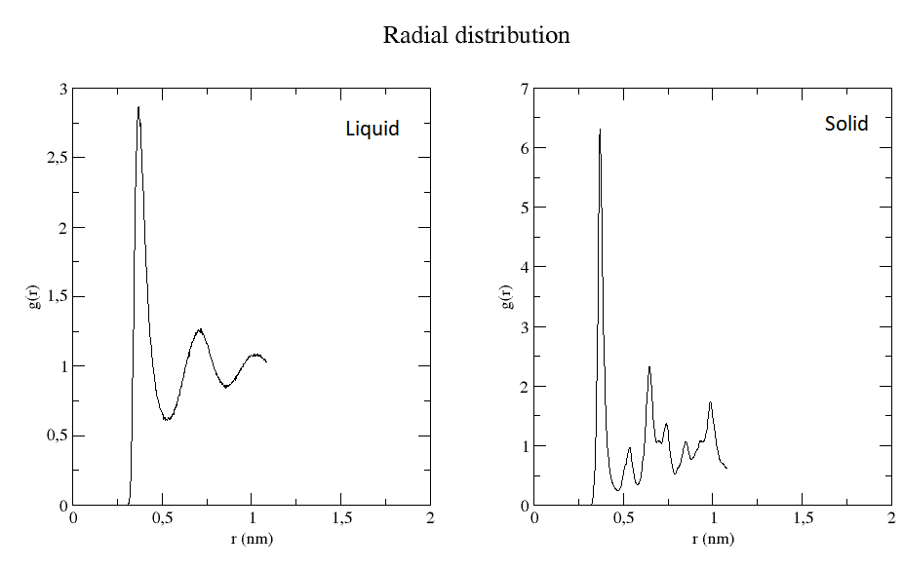
Radial Distribution Function
Notes:
Highest peak → nearest neighbour at ca r=0.37
Solids:
more densly packed → more atoms at given r → higher peaks
The second „big“ peak at twice the distance than first → constant structure
Liquids:
Broader peaks because of more motion(vibration of molecules)
Second peak further away

Slide 10
Outlook
Enhance Argon project:
Observe longer time period
Simulate: gas → fluid → solid or solid → fluid → gas
Use different ensemble: NTP
Simulate different Atoms

Slide 11
Bibliography
- Tutorial: http://cmb.bio.uni-goettingen.de/pract/p1/
- Introduction to molecular dynamics: https://www.neutron-sciences.org/articles/sfn/pdf/2011/01/sfn201112009.pdf
- used programs: GROMACS (http://www.gromacs.org/), VMD (https://www.ks.uiuc.edu/Research/vmd/), pymol (https://pymol.org/2/), R (https://www.r-project.org/), ggplot2 (https://ggplot2.tidyverse.org/)

